Slide 1

“Inners” Setup Training
Version 1.3
Bappaditya Banerjee

Slide 2
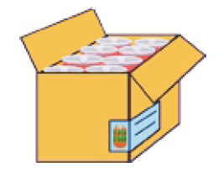
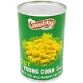
ITEM - LEVEL DEFINITION : Non-Inner
Simple Pack of 192 Eaches
Item Qty = 192
Case Qty = 1 (always 1)
Unit Cost = $96 (Item unit cost * Pack Item Qty)
Case Cost = $96 (Pack Unit Cost * Pack Case Qty)
Step 1
Create
Regular Item
Each
Case
Item Level = I
Transaction Level = 2
UCC 12
Parent Level/Style
Step 2
Create
Simple Pack (Outer)
Store SOH is
held at the
each
SKU/Transaction Level Item/TPNB
Simple Pack (Outer)
Item Level = 2
Transaction Level = 2
ORIN
Item Level = 1
Transaction Level = 1
ORIN
Case of 192 Eaches
Inner Qty = 1
Case Qty = 192
Unit Cost = $0.5
Case Cost = $96
WH SOH is
Held at the
simple pack
Item Level = 3
Transaction Level = 2
EAN 8/13 / UCC12
Outer Case Code
Item Barcode
Item Level = 2
Transaction Level = 1
EAN/UPC 14

Slide 3

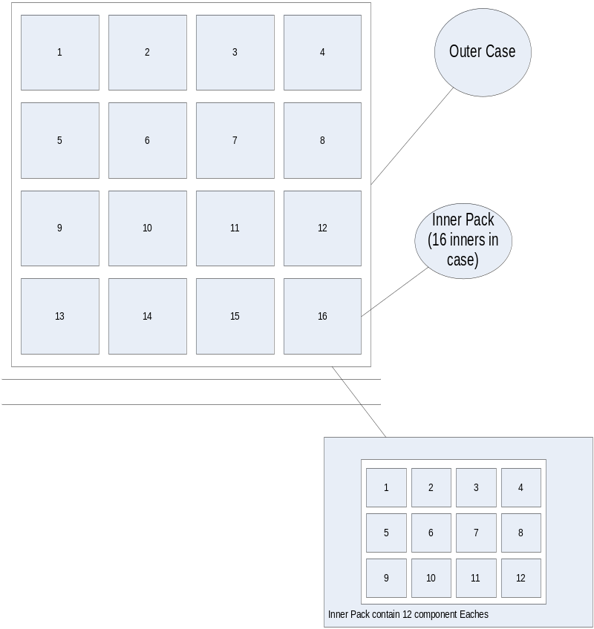
The Item (Inner)
Sellable Item = ECLIPSE GUM PEPPERMINT 16/12CT
Inner Size = 12 (12 EA in an Inner)
Case Size = 16 Inners (16 Inners per Case)
Hence the Master Case will have 12 * 16 = 192 consumer units
Inner Barcode = 022000149978
Unit Barcode (Suppressed) = 02299709
Unit Barcode (UPC) = 022000009975
Unit Cost = $0.5
Inner Cost = $6
Case Cost = $96

Slide 4
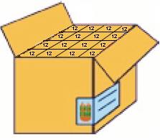
ITEM - LEVEL DEFINITION - Inners
Simple Pack (Inner) of 12 Eaches
Item Qty = 12
Case Qty = 16 (Inners per Case)
Unit Cost = $6 (Item unit cost * Pack Item Qty)
Case Cost = $96 (Pack Unit Cost * Pack Case Qty)
Step 1
Create
Regular Item
Each
Parent Item/Style
Item Level = I
Transaction Level = 2
UCC 12
Case with Inners
Step 2
Create
Simple Pack (Inner)
Store SOH is
held at the
each
SKU/Transaction Level Item
Simple Pack (Inner)
Item Level = 2
Transaction Level = 2
ORIN
Item Level = 1
Transaction Level = 1
ORIN
Case of 192 Eaches
Inner Qty = 12
Case Qty = 192
Unit Cost = $0.5
Case Cost = $96
No Level 2 for Simple Pack
WH SOH is
Held at the
simple pack
Item Level = 3
Transaction Level = 2
EAN 8/13 / UCC12
Item Barcode

Slide 5
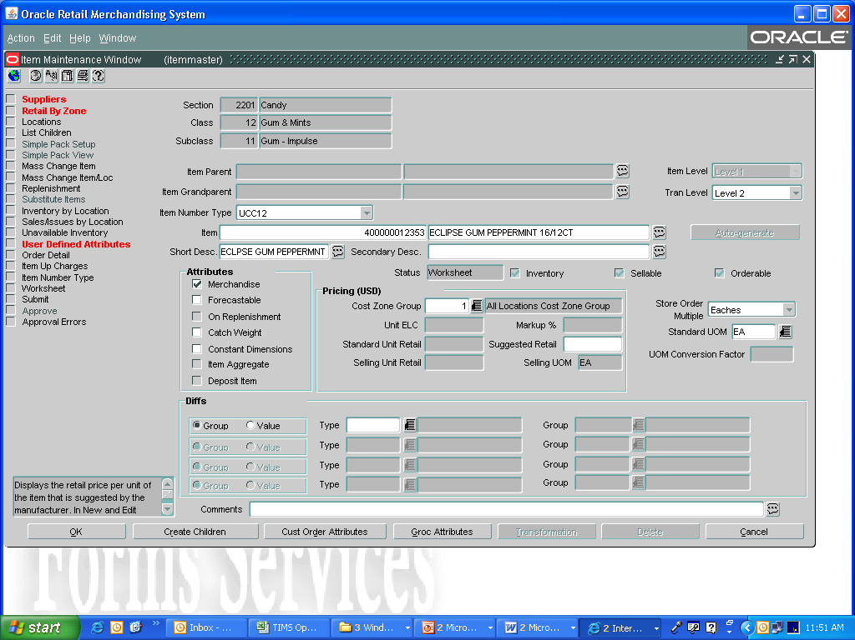
Item Setup in RMS – Level 1

Slide 6
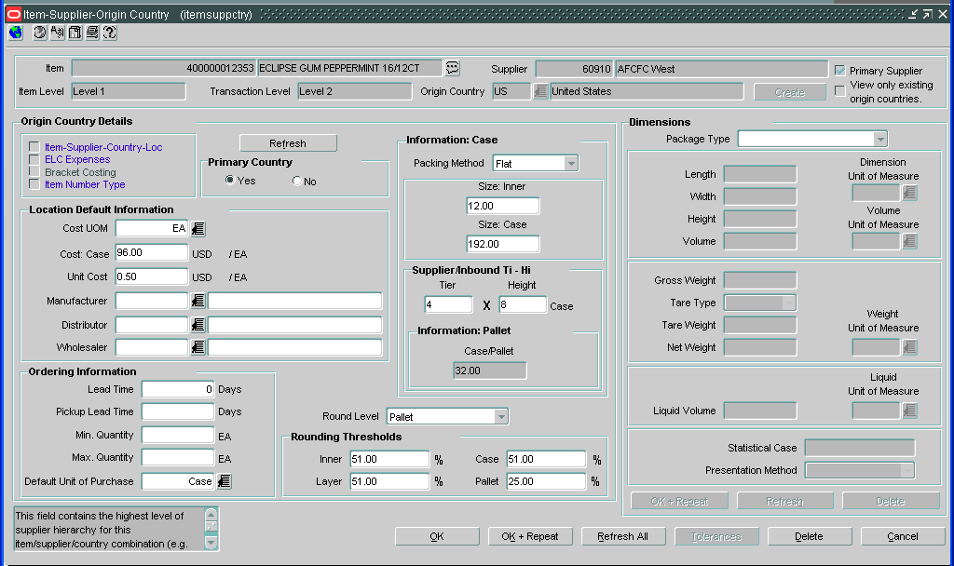
Item Supplier/Country Setup
2
1

Slide 7
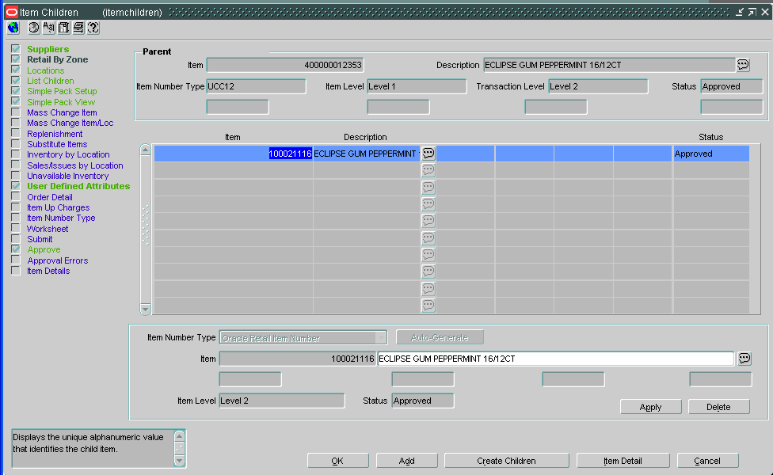
Item Setup in RMS – Level 2

Slide 8
Barcode Formats for Inners (Level 3)
Branded Products = UCC12
  Suppressed Unit Barcodes (8 digits) should be expanded to the Extended 12 digit UPC
  Suppressed Barcodes typically will start with “0” for Branded Items
  Supplier Provided in the Spec Sheet
  Visit http://www.morovia.com/education/utility/upc-ean.asp
Private Label Products = EAN/UCC8
  For Tesco, this will typically start with “2”
  Select “EAN/UCC8” as Barcode Type and enter the 8 digit number

Slide 9
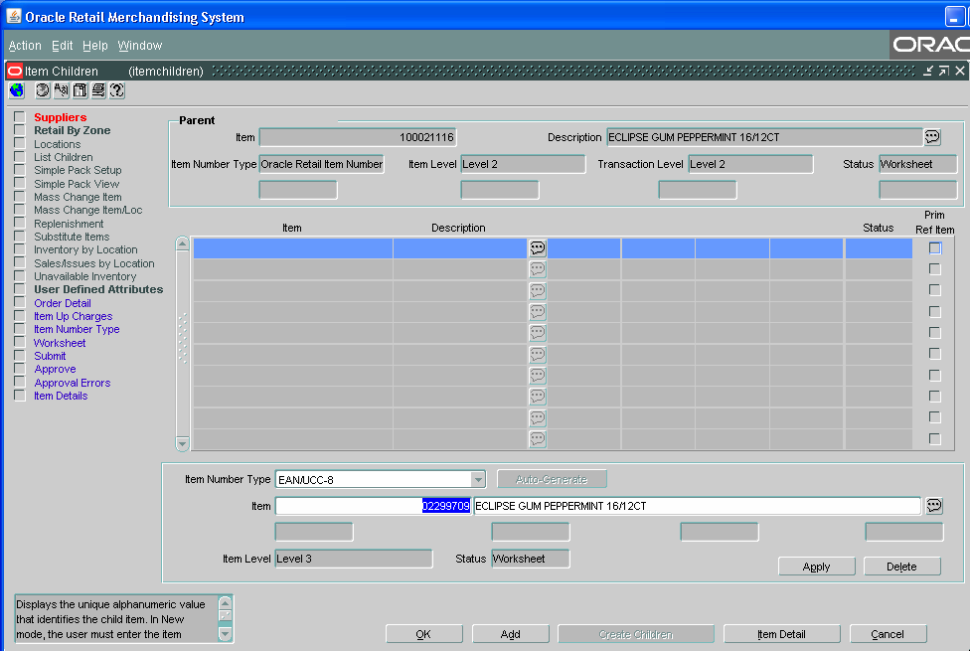
Item Setup in RMS – Level 3

Slide 10
Naming Convention – Inner Packs
The Outer Case Pack contains Inners which is
Always broken down at the DC into Inners and
Shipped to Stores/Other DC’s
Hence it is a Break Pack
Sellable Unit Description = ECLIPSE GUM PEPPERMINT
Inner Size (Consumer Units per Inner) = 12
Total Boxes (Inners) per Case = 16
Hence total no. of Consumer Units/Outer Case = 192
Simple Pack Name = BP_ECLIPSE GUM PEPPRMINT 16/12
Maximum 30 Characters
Naming Convention
BP_[Brand Name][Product Description] [Inners per Case]/[Eaches per Inner]
BP = Break Pack
Brand Name = Doublemint, Altoids
Product Description
Inners per Case = No. of Inners in the Master Case
Eaches per Inner = No. of Eaches per Inner

Slide 11
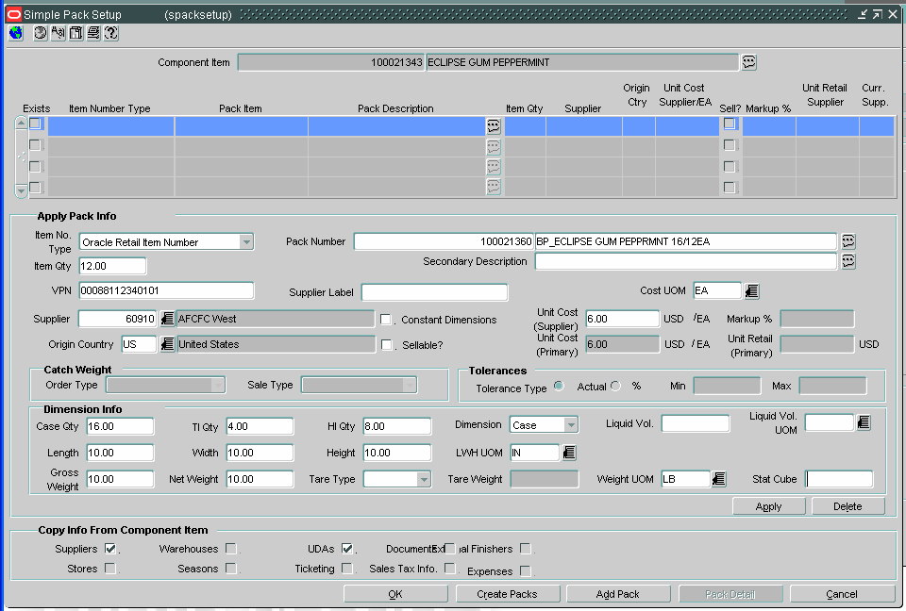
Item Setup in RMS – Simple Pack Setup
1
2
5
3
4
6
7

Slide 12
Inner Item Setup Ends Here
The following Slides are for validation ONLY

Slide 13
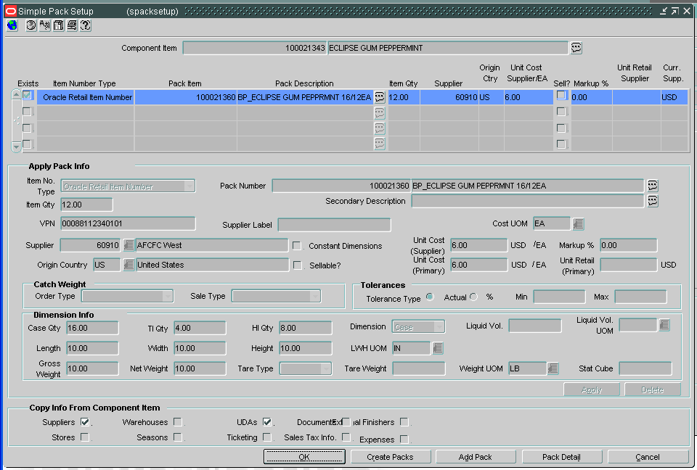
Item Setup in RMS – Pack Detail
After creating the Pack click on ‘Pack Details’ to go to the Pack/Item Master screen

Slide 14
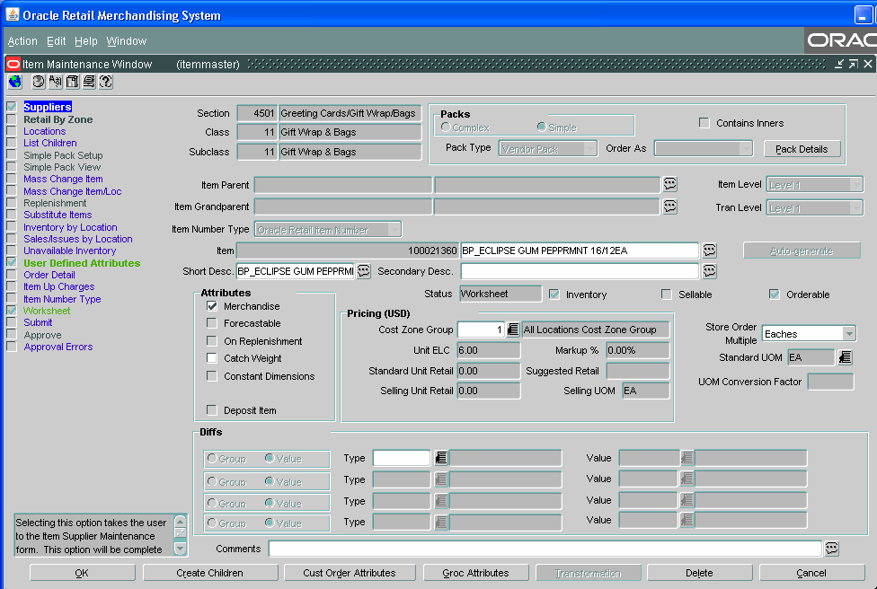
Item Setup in RMS – Item Master (Inner Pack)
Click ‘Supplier’ to validate Supplier & Case Setup for Inner Pack
Make Sure that the Unit ELC = Inner Cost (Unit Cost of the Inner Pack)

Slide 15
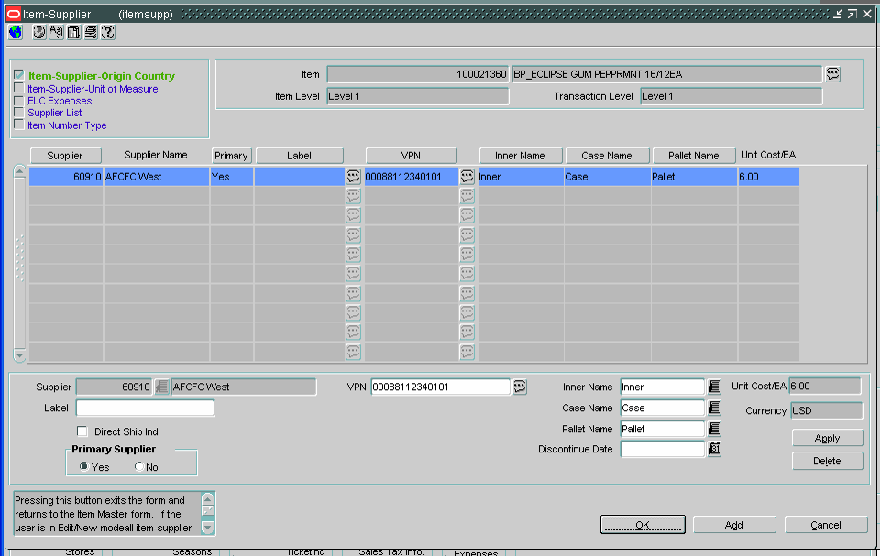
Item Setup in RMS – Simple Pack Supplier Setup
Click on ‘Item Supplier-Origin Country’ to enter Inner Pack Supplier/Country setup
Validate the VPN field is populated with the OCC for the Master Case (14 digits)

Slide 16
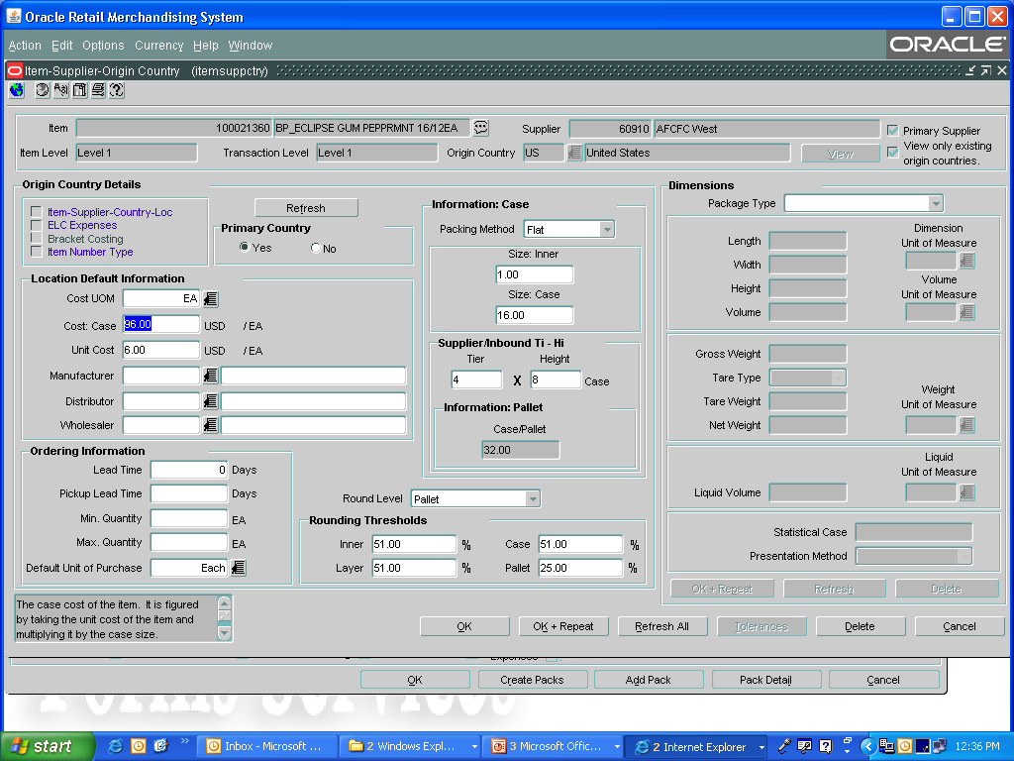
Item Setup in RMS – Simple Pack Supplier/Country Setup
Make Sure that the Inner Size = 1 (Always 1) for the Inner Simple Pack
Make Sure that the Case Cost = Cost of the Master Case
Make Sure that the Case Size = Number of Inners in the Master Case
Make Sure that the Unit Cost = Inner Cost (Unit Cost of the Inner Simple Pack)

Slide 17
Thank You

